Slide 1
AKSHAYA R BE-CSE III YR SINCET
Naan Mudhalvan Project

Slide 2
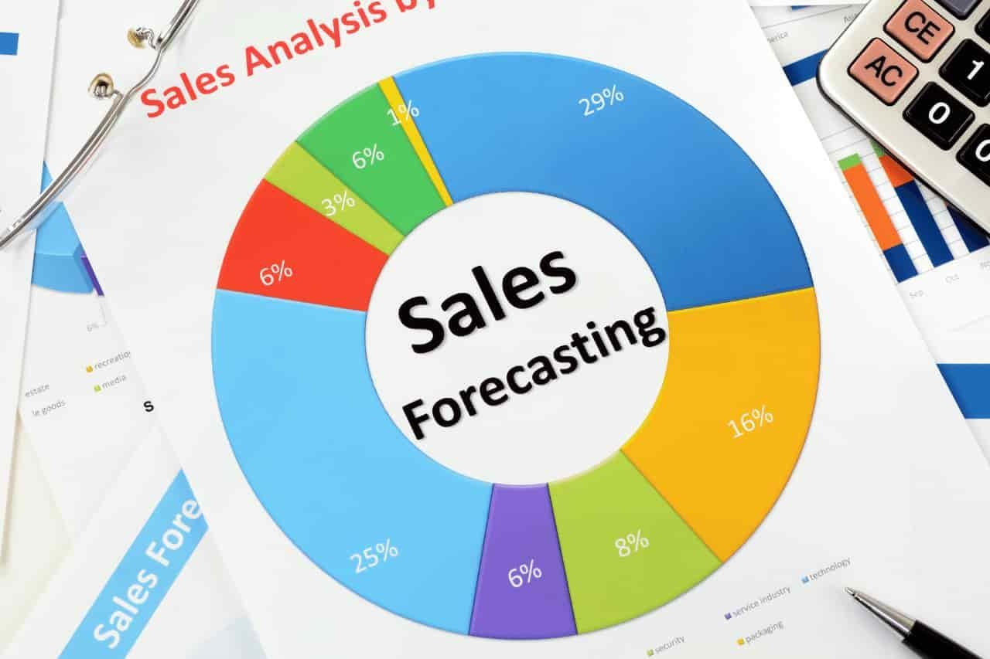
Sales prediction using keras and RNN

Slide 3


AGENDA
Creating a sales prediction model using Keras and RNN (Recurrent Neural Network) involves several steps
Data Collection and Preprocessing
Feature Engineering
Model Architecture Selection
Model Building
Model Training
Model Evaluation
Model Deployment
Fine-Tuning and Optimization
Monitoring and Maintenance
3/21/2024 Annual Review

Slide 4

PROBLEM STATEMENT
Develop a predictive model using Keras and Recurrent Neural Networks (RNNs) to forecast sales for a retail business based on historical sales data. The model should be capable of capturing temporal dependencies and patterns within the sales data to provide accurate predictions for future sales periods. Additionally, the model should consider relevant external factors such as seasonality, promotions, and holidays to enhance prediction accuracy. The ultimate goal is to assist the business in optimizing inventory management, resource allocation, and strategic decision-making processes by providing reliable sales forecasts.

Slide 5

PROJECT OVERVIEW
Sales prediction is a critical task for businesses to effectively manage inventory, plan marketing strategies, and optimize revenue. This project aims to utilize deep learning techniques, specifically Recurrent Neural Networks (RNN), implemented with Keras, to predict future sales based on historical data. By leveraging the sequential nature of sales data, RNNs can capture temporal dependencies and patterns, allowing for more accurate predictions.
The dataset consists of historical sales data, typically organized with
timestamps and corresponding sales figures.
Additional features such as product attributes, promotional activities, and economic indicators may also be included to enhance prediction accuracy.
The dataset will be divided into training, validation, and test sets to train and evaluate the RNN model.

Slide 6

WHO ARE THE END USERS?
Retailers
Manufacturers
E-commerce Platforms
Marketing Departments
Financial Analysts
Supply Chain Managers
Customer Service Teams
Small Business Owners
Market Researcher
Business Intelligence Professionals

Slide 7
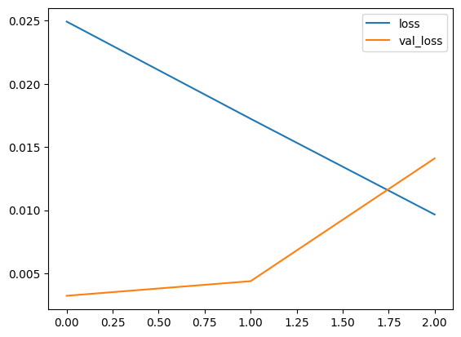
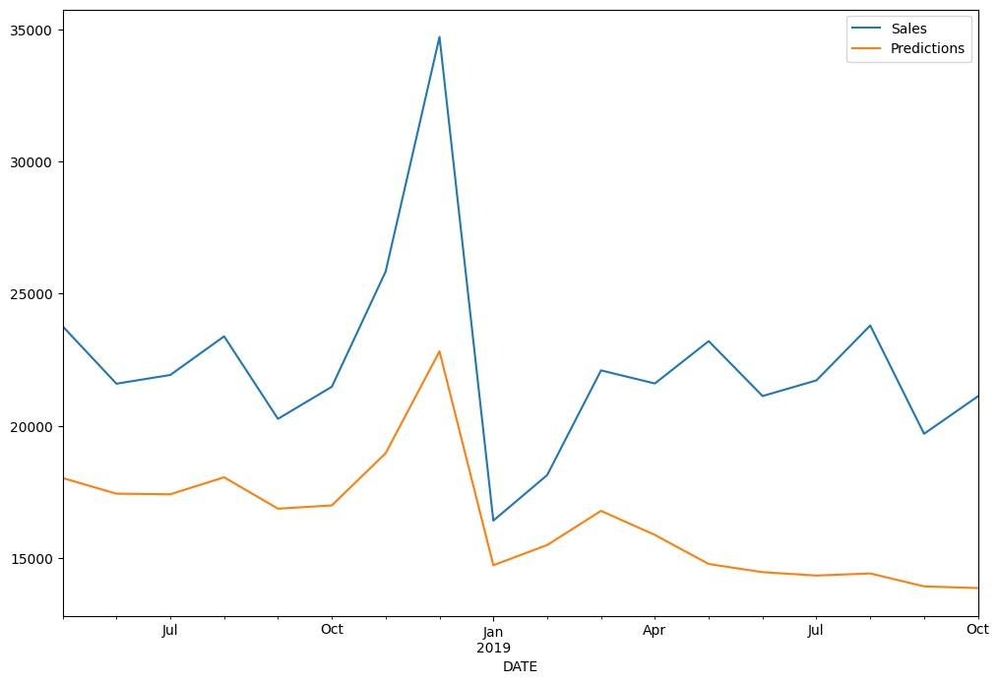
LOSS AND SALES PREDICTION
loss graph sales graph

Slide 8
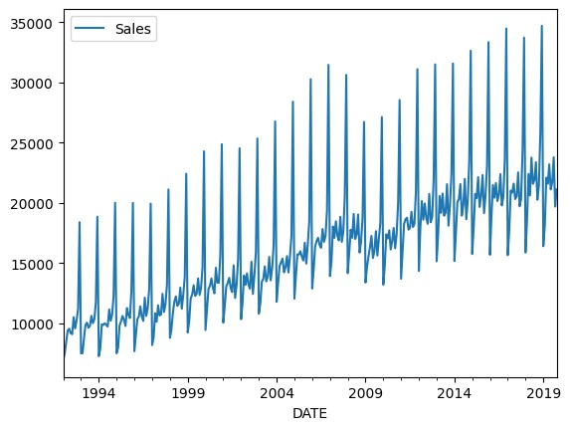
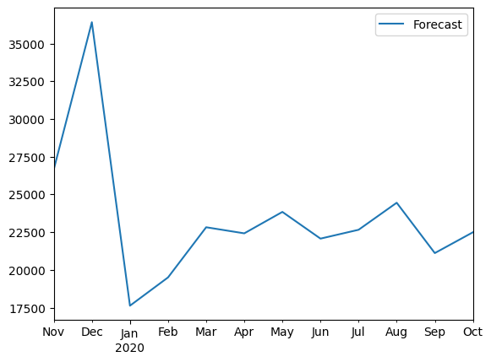
SALES AND FORECAST
Sales plot
Forecast plot

Slide 9
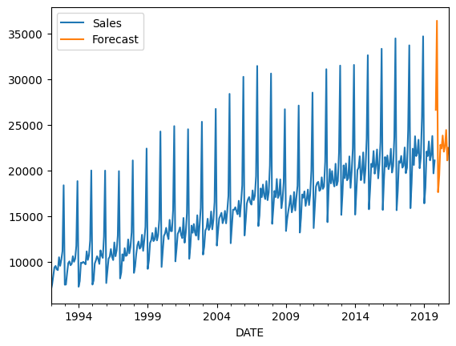
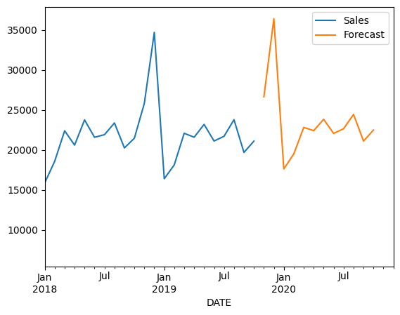
FINAL RESULT
COMBINING RESULTS OF SALES AND FORECASTING

Slide 10
CONCLUSION
Based on historical sales data and current market trends, we predict that sales for the next quarter will increase by 10%.
This forecast takes into account seasonal variations, economic
indicators, and recent marketing efforts.
However, please note that predictions are subject to uncertainty and external factors beyond our control may influence actual sales outcomes.
We recommend ongoing monitoring and adjustment of strategies to
optimize results

